Slide 1
UNCONVENTIONAL BUSINESS MODEL

Slide 2
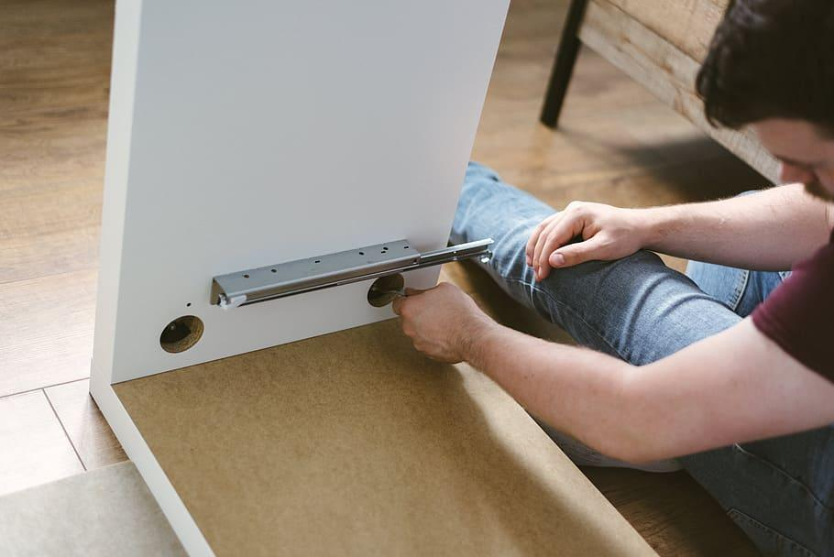
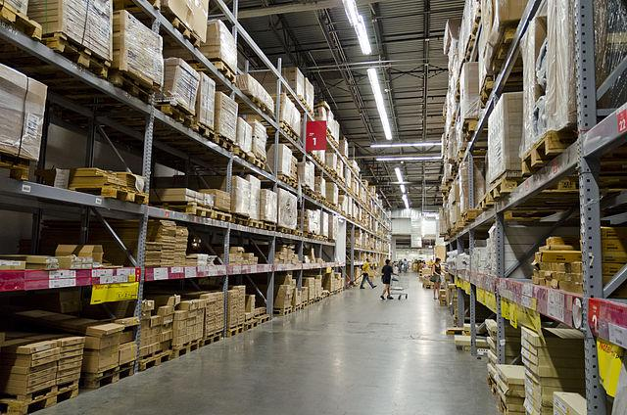
Look at the photographs and discuss the questions
Do you enjoy doing the activity in the first picture?
How could the two pictures be connected?

Slide 3
Vocabulary
Discuss the differences between the words or phrases in each pair.
Then, decide which of them you can see in the pictures on the previous slide.

Slide 4
retailer / wholesaler

Slide 5
warehouse store / department store

Slide 6
flat-packed furniture /
pre-assembled furniture

Slide 7
unconventional product names / unoriginal product names

Slide 8
designated road / winding road

Slide 9
maze / path

